Slide 1
CHAPTER 3
DERIVATIVES

Slide 2
CONTENTS
3.1. Derivatives
3.2. Derivative as a Function
3.3. Differentiation Formulae
3.4. Rates of Change in the Natural and Social Sciences
3.5. Derivatives of Trigonometric Functions
3.6. The Chain Rule
3.7. Implicit Differentiation
3.8. Derivatives of Logarithmic Functions
3.9. Related Rates
3.10. Linear Approximations and Differentials

Slide 3
3.7. IMPLICIT DIFFERENTIATION
3.7.1. Implicit Differentiation
3.7.2. Orthogonal Trajectories
3.7.3. Derivatives of Inverse Trigonometric Functions

Slide 4
3.7.1 Implicit Differentiation
So far, the functions we met are given by an expression describing the dependence of a variable y on an independent variable x such as
However some functions are defined implicitly by a relation between x and y that are not easy to solve for y as an explicit function of x, such as
(1) x² + y² = 25 or
(2) x³ + y³ = 6xy

Slide 5
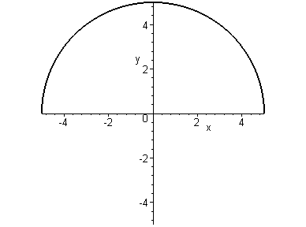
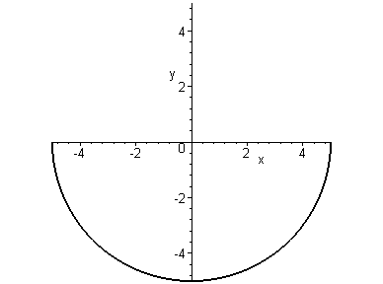
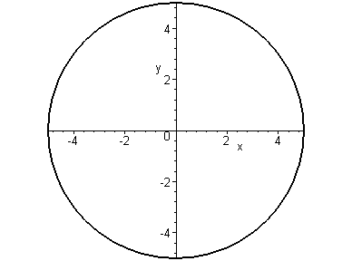
The equation (1) has as solutions, 2 functions f and g:
The graphs of f and g
and the graph the curve (1)

Slide 6
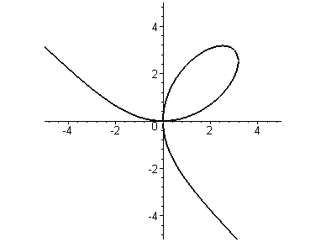
The curve (2) is called the folium of Descartes
(2) x³ + y³ = 6xy

Slide 7
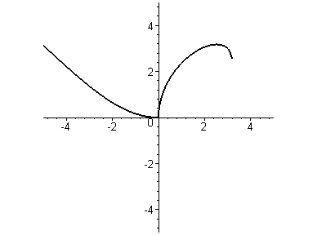
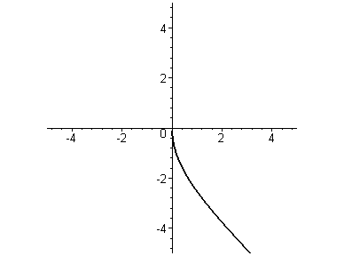
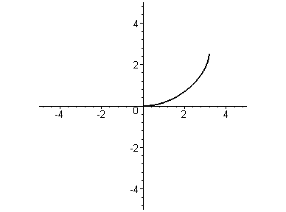
It is hard to solve (2). However it can be proved that (2) has as solutions, several functions f such that:
x³ + [f(x)]³ = 6x f(x)
f₂
f₁
f₃

Slide 8
Fortunately, we don't have to solve the equation to find the derivative of y with respect to x. In general an implicit function is defined by an equation
(3) F(x,y) = 0
The implicit function Theorem says that under certain conditions, we can solve (3) to get a differentiable function y=f(x) on an interval I, i.e.
(4) F(x,f(x)) = 0 for all x ∈ I
To find f', we need only to differentiate both sides of (3) with respect to x, using the Chain Rule

Slide 9
Example. (a) if x² + y² = 25, find dy/dx
Solution. Differentiate both sides of the equation
By the Chain Rule
Thus

Slide 10
(b) Write the equation of the tangent to the above circle at the point (3, 4)
Solution 1. Notice that the point (3, 4) belongs to the circle (1)

Slide 11
Solution 1. the slope of the tangent to the above circle at the point (3, 4) is
Therefore the equation of the tangent to the above circle at the point (3, 4) is

Slide 12
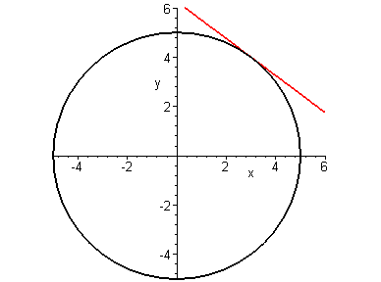
The tangent to the above circle at the point (3, 4)

Slide 13
Solution 2. The point (3,4) lies on the upper semicircle
which is the graph of the function
We have by applying the Chain Rule
The equation of the tangent at the point (3, 4) is obtained as above

Slide 14
Note 1. Even if it is possible to solve an equation explicitly, it is easier to get the derivative using implicit differentiation
Note 2. The derivative dy/dx= -x/y is correct no matter which solution of (1) being used.
For instance the derivative of the function
would satisfy the same relation

Slide 15
Example. (a) Find y’ if x³ + y³ = 6xy (2)
(b) Find the tangent at the point (3,3)
Solution. Differentiating both sides of (2) and using the Chain Rule and the Product Rule we get
Therefore

Slide 16
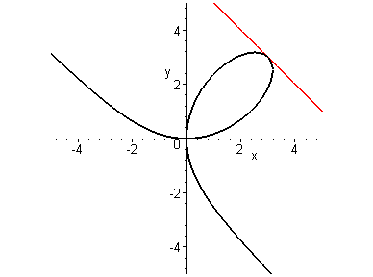
(b) When x=y=3 we have
The equation of the tangent at the point (3,3)
y – 3 = - (x-3) or x + y = 6

Slide 17
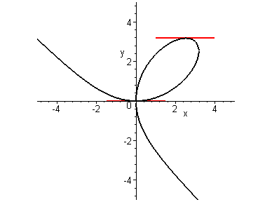
(c) At what point of the curve, the tangent is horizontal?
Solution. Recall that
Therefore the tangent is horizontal when y' = 0, i.e. 2y=x². Substituting the value of y in (2) we get
So the tangent is horizontal at (0, 0), (2^{4/3}, 2^{5/3})

Slide 18
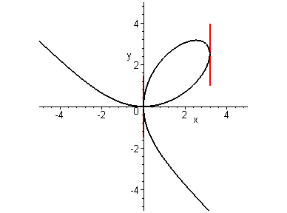
(c) At what point of the curve, the tangent is vertical?
The tangent is vertical when y' = ∞, i.e. 2x=y². The corresponding y-coordinates are the solution of the equation y⁶=16y³.
We obtain two points (0, 0),
(2^{5/3}, 2^{4/3})

Slide 19
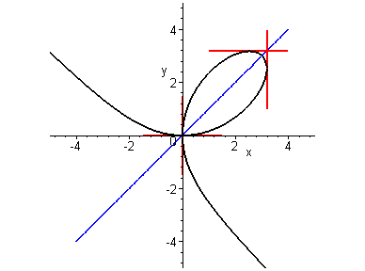
(2) x³ + y³ = 6xy
Notice that the curve (2) is symmetric with respect to the line y=x.
So the points where the tangents are vertical are reflections of those where the tangents are horizontal

Slide 20
Note. We can solve (2) in y as a function of x by using the following MAPLE command
> f:=solve(x^3+y^3-6*x*y,y);
Solution 1

Slide 21
Solution 2

Slide 22
Solution 3

Slide 23
Remark. It is impossible to solve an equation such as
y⁵ +3x²y² + 5x⁴ = 12
However we can use implicit differentiation to get the derivative y' as an expression depending on both x and y
Then we use this expression to obtain information on the slope of the tangent at some specific points

Slide 24
Example. Find y' if sin (x+y)=y ²cosx
Solution. Using implicit differentiation we get
cos(x+y)(1+y')= 2yy'cosx - y ²sinx
cos(x+y)+ y ²sinx= (2ycosx – cos(x+y)).y'

Slide 25
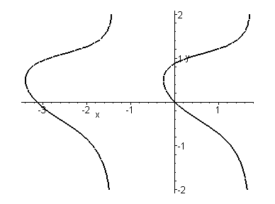
The graph of the curve sin (x+y)=y ²cosx by using MAPLE command implicitplot
> with(plots):
> implicitplot(sin(x+y)-y^2*cos(x),x=-4..2, y=-2..2);

Slide 26
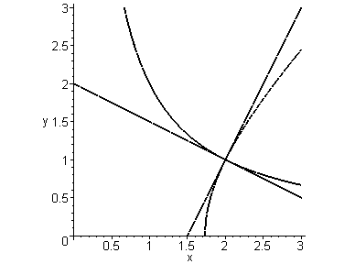
3.7.2 Orthogonal Trajectories
Two curves are called orthogonal if at each point of intersection their tangent lines are perpendicular

Slide 27
Two families of curves are orthogonal trajectories of each other if every curve in one family is orthogonal to all curves in the other family
Orthogonal trajectories occurs in:
Electrostatics
Thermodynamics
Hydrodynamics
etc…etc…

Slide 28
Example. The following equations represent two families of hyperbolas
(1) x y = c, c ≠ 0
(2) x² – y² = k, k ≠ 0
Show that they are orthogonal trajectories
Solution. For given c ≠ 0, the curve x y = c is a hyperbola with asymptotes the two axis
On the other hand for given k ≠ 0, the curve x² – y² = k is a hyperbola with asymptotes the two lines y = x and y = -x

Slide 29
(1) x y = c, c ≠0
(2) x² – y² = k, k ≠0
Differentiating implicitly (1) and (2) we get
Therefore at each point of intersection their tangent lines are perpendicular, i.e. the two families are orthogonal trajectories

Slide 30
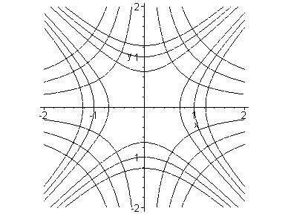

Slide 31
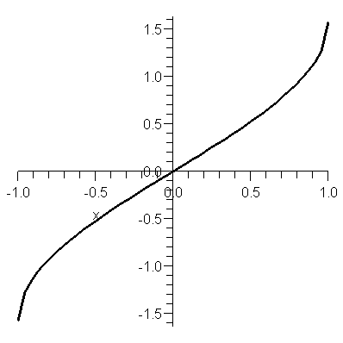
3.7.3. Derivatives of Inverse Trigonometric Functions
We can use implicit differentiation to obtain derivatives of inverse trigonometric functions.
Recall that the inverse function of y = sinx is the function y = sin⁻¹x with domain (-1, 1) and range (-π/2 , π/2)

Slide 32
We can use implicit differentiation to obtain the derivative of inverse function y = sin⁻¹x
We have
y = sin⁻¹x ⇔ siny = x
Differentiate implicitly the last equation w.r.t. x

Slide 33
Similarly
y = tan⁻¹x ⇔ tan y = x -π/2 < y < π/2
Differentiate implicitly the last equation w.r.t. x

Slide 34
Example. Differentiate
Solution.

